Slide 1

RAINWATER HARVESTING AND WATER CONSERVATION MONITOR
S.E.(I.T.) / Sem III / COMMMUNITY PROJECT II 2026-2027
The Bombay Salesian Society’s Don Bosco Institute of Technology
Department of Information Technology
Heremb Chopade (62) , Ayush Jage (02),
Vinayak Sahu (55), Melwin Mullaparambil (58)
Date: August 24 , 2026
Supervisor(s): Prof. Tayyabali S. / Prof. Prasad P. Prof. Shiv Negi

Slide 2
Introduction
Problem Context: Farmers in Maharashtra face increasing water scarcity and unpredictable rainfall, making effective water management difficult. Many lack access to affordable tools and technical guidance for rainwater harvesting and conservation.
Project Objective: To develop a simple, farmer-friendly platform that helps record rainfall and land data, assess land conditions, and provide practical water conservation recommendations without requiring special equipment.
Significance: The project promotes sustainable water use, improves farmer awareness, supports climate-resilient agriculture, and contributes to SDG 6 (Clean Water and Sanitation) and SDG 13 (Climate Action).

Slide 3
Problem Statement
The project addresses the problem of unpredictable rainfall, water scarcity, and low adoption of rainwater-harvesting practices among farmers in Maharashtra. A survey of 15 local farmers found that 67% (10/15) had no rainwater-harvesting structure, while technical knowledge, maintenance, and climate uncertainty were major barriers. Existing solutions mainly focus on system design or general awareness but lack an accessible, equipment-free farmer-facing planning tool. Therefore, the proposed Rainwater Harvesting & Water Conservation Monitor aims to provide simple land and rainfall data tracking, water-conservation recommendations, land-fertility insights, low-cost manual methods, optional mechanization guidance, and trusted learning resources through a Website-responsive platform.

Slide 4
Literature Review / State of the Art
Research / Existing Solution | Key Strength / Finding | Limitation / Gap
RWH System Design for Smallholder Farmers (2021) | Improves rainwater-harvesting design and addresses poor system siting. | Design-focused; no farmer-facing digital planning tool.
Farmers’ Profiles & Attitudes Toward RWH (2023) | Identifies awareness and cost savings as major adoption factors. | Focuses on attitudes; does not develop a support system.
RWH & Treatment – State of the Art (2023) | Covers low-cost as well as advanced RWH technologies and SDG relevance. | Broad review; not tailored to Indian smallholder farmers.
RWH for Agricultural Irrigation – Global Analysis (2019) | Shows strong global research interest and highlights the adoption gap. | Does not provide an integrated farmer-support solution.
Proposed Monitor | Combines equipment-free tracking, land/fertility insights, conservation guidance and trusted learning resources. | Aims to bridge the gap between RWH research and practical farmer adoption.

Slide 5
SDG Alignment & Justification
SDG 6
SDG 13
SDG 15
Clean Water & Sanitation
Climate Action
Life on Land
Improves rainwater storage & usage efficiency for farming households
Helps farmers adapt to unpredictable, increasingly erratic rainfall patterns
Land fertility tracking supports sustainable soil and farmland management
Justification: Water security is fundamentally tied to farmer livelihoods and food security. This project directly addresses the survey's top-cited barriers — technical knowledge, maintenance, and climate uncertainty — making it a natural fit for these three SDGs.

Slide 6
Proposed Approach / Methodology
Login / Register
Land Biodata Panel
Farmer inputs land area, water source, soil indicators — includes a simple rainfall/storage calculation using tools already available on the farm (bucket + timer, ruler, etc.), no special equipment needed
Land Biodata Submitted
AI/rule-based engine processes the entry
Conservation Monitoring Panel
System generates next-step recommendations
Manual Low-Cost Methods
Optional Mechanization
Authentic Learning Resources
Step-by-step conservation techniques using materials the farmer already has — the default recommendation path
Suggested only if the farmer wants to invest more — pumps, lined ponds, automated tanks
Curated videos & guides from agricultural research institutes for self-paced learning

Slide 7
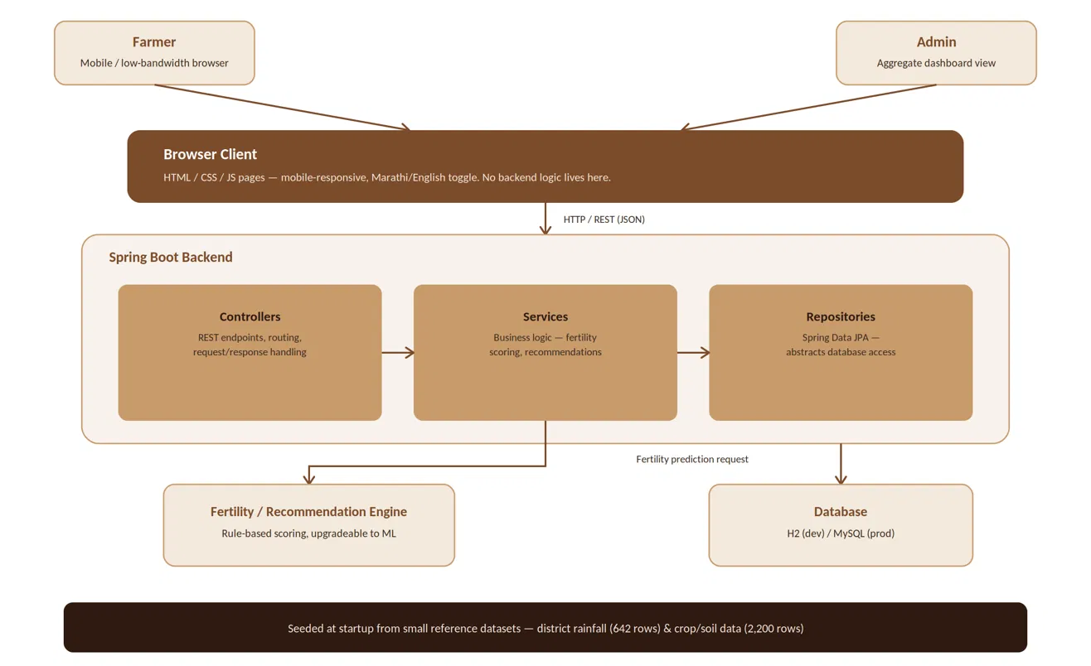
Implementation (Partial)

Slide 8
Database Details
642 rows × 19 columns
One row per Indian district with monthly, seasonal & annual rainfall figures. Small enough to load entirely into H2 at startup — grounds the water-calculation logic in real historical data.
Rainfall in India (District-Wise) — Kaggle
2,200 rows × 8 columns
N, P, K, temperature, humidity, pH and rainfall per record, mapped to a suitable crop. Powers the rule-based soil/fertility thresholds behind the Land Biodata panel.
Crop Recommendation Dataset — Kaggle
15 rows, Marathi + English
Primary, locally-collected ground-truth data on adoption, barriers & training interest — used for problem justification and feature priority, not for model training.
Own Farmer Survey — 15 responses

Slide 9
Conclusion
The Rainwater Harvesting & Water Conservation Monitor addresses a real, locally-verified gap in farmer water management — low RWH adoption paired with strong interest in guidance but limited technical support and no accessible tool.
By combining a Spring Boot-based platform with manual, equipment-free guidance as the default path, optional mechanization suggestions, and authentic research-institute learning content, the project offers a practical, farmer-first tool that generic advisory solutions don't — directly supporting SDG 6, 13, and 15.

Slide 10
References
Odhiambo, K.O. et al. — Optimization of rainwater harvesting system design for smallholder irrigation farmers in Kenya: a review — AQUA, 70(4), 2021
Mesa-Vázquez, E. et al. — Farmers' profiles and attitudes towards the implementation of rainwater harvesting systems in intensive agriculture — 2023
Rainwater Harvesting and Treatment: State of the Art and Perspectives — Water (MDPI), 2023
Rainwater Harvesting for Agricultural Irrigation: An Analysis of Global Research — Water (MDPI), 2019
Rainfall in India (District-Wise) — Kaggle dataset
Crop Recommendation Dataset — Kaggle dataset
Own primary survey — Rainwater Harvesting & Water Conservation farmer survey (15 respondents)

Slide 11
THANK YOU

